Slide 1
Take a look at python and jupyter notebooks
Installation
Anaconda python distribution includes most packages needed for this course
Step-by-step installation guide for Windows/Mac/Linux https://docs.anaconda.com/anaconda/
Quick start guide for jupyter notebooks https://jupyter.readthedocs.io/en/latest/content-quickstart.html
Alternative
Jupyter notebook environment Google Colab https://colab.research.google.com/notebooks/welcome.ipynb
Free, requires no setup, runs entirely in the cloud

Slide 2
The Data Science Process

Slide 3
Famous classification algorithms
Decision tree
Random forest
XG boost
Support vector machine
K-nearest neighbor
Neural Network
Bayes classifier
Ensemble

Slide 4
Decision tree Support vector machines

Slide 5
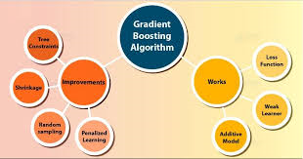
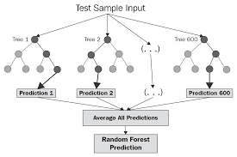
XG Boost Random forest

Slide 6
Decision tree Support vector machines

Slide 7
K-nearest neighbors Neural Networks

Slide 8
Bayes Classifiers Ensembles

